Slide 1
Big data technology ”Stock Analysis”
Submitted By
Bibek Thokar
Madhav Thapa
Daniel Kassampu Tshimanga

Slide 2
Technologies Used
Cloudera Quick Start VM 5.12
Hadoop 2.7.7
Java JDK & JRE Version 8
Kafka 3.5.0
Spark 3.5.0
Hbase 1.2.12

Slide 3
Project Overview
Designed and developed end to end project using kafka as a data injection , Spark Streaming as kafka consumer and real time analysis and Hbase to store the final result in real time

Slide 4
Architecture Overview
CoinmarketCap
Kafka
Spark Streaming
HBase

Slide 5
Architecture Overview
Spark Streaming
Getting data from CoinMarketCap using API
We used “Listing” GET API https://pro-api.coinmarketcap.com/v1/cryptocurrency/listings/latest
Create a kafka producer to send latest cyptocurrencies data with 10 seconds of interval

Slide 6
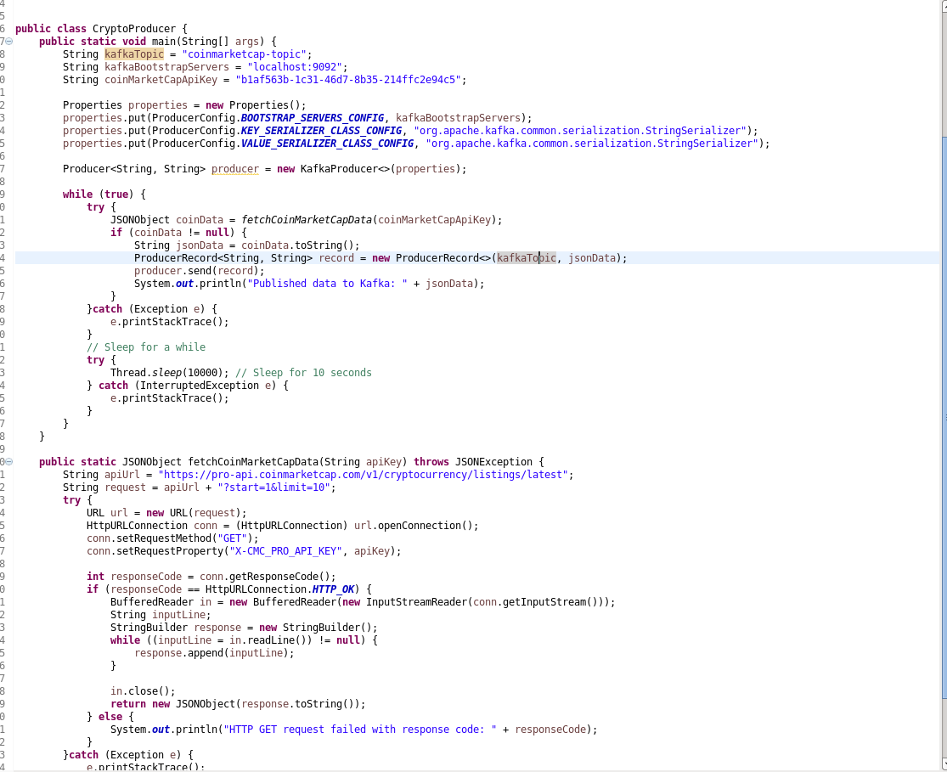
Architecture Overview

Slide 7
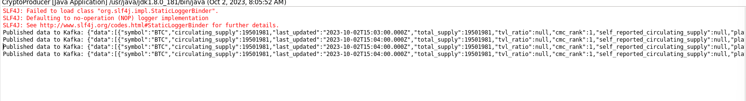
Architecture Overview

Slide 8
Architecture Overview
Spark Streaming
Receive cryptocurrency data from kafka and pass to spark
Spark convert JSON data to JAVA classes and perform analysis
We are analyzing and calculating average price of cryptocurrency in 1 minutes where in every 10 seconds we get a new price from API.
We used movingwindow to calculate the average price where window duration and slide duration are set to 60 seconds for real time data.

Slide 9
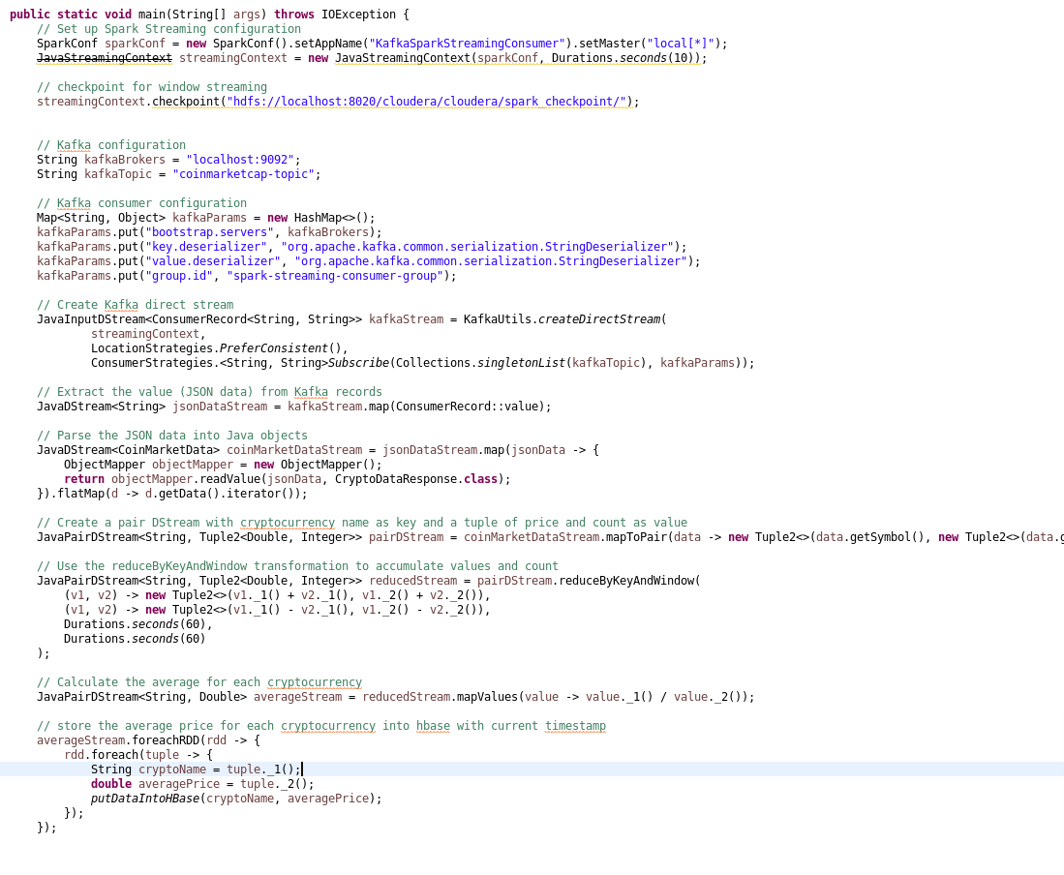
Architecture Overview

Slide 10
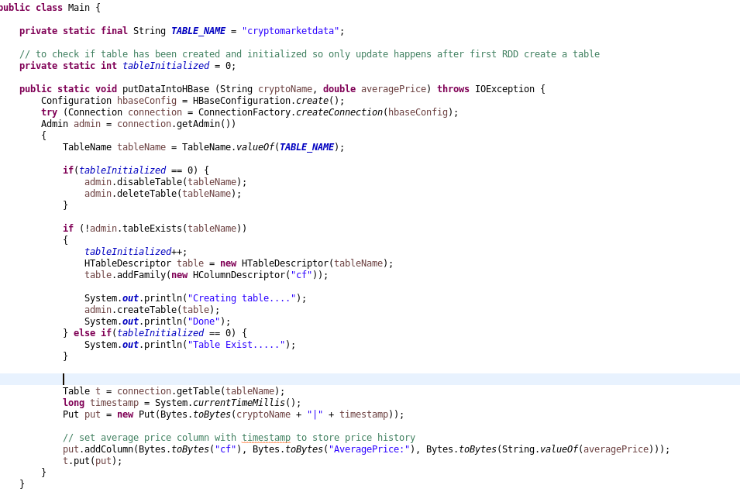
Architecture Overview

Slide 11
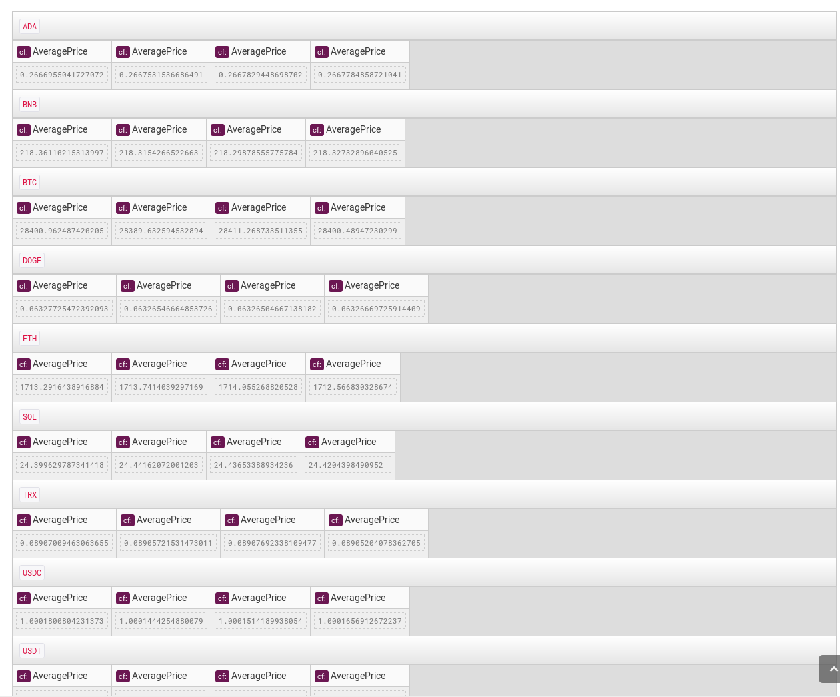
Architecture Overview

Slide 12
Demo Steps
Step 1:
Download Kafka from https://kafka.apache.org/downloads
Extract at /home/cloudera/kafka
Start the zookeeper service “bin/zookeeper-server-start.sh config/zookeeper.properties”
Start the kafka broker service “bin/kafka-server-start.sh config/server.properties”

Slide 13
Demo Steps
Step 2:
Run KafkaCryptoProducer application
It fetched the data from coinmarketcam and published as a JSON data to a topic.
Step 3:
Run CryptoAnalysis application
It consumes the kafka topic and do analysis using spark streaming
Final results are store in HBase

Slide 14
Resource Links
https://github.com/bibekthokar/BDT-CryptoAanalyis

Slide 15




Thank you
Prof. Mrudula Mukadam

